Slide 1
Lecture 19

Slide 2
Combination of Lenses

Slide 3
I₁
O₂
f₁
f₂
O₁
f₁
f₂
I₂
d_{o1}
d_{i1}
d_{o2}
d_{i2}
s₁
s’₁
s₂
s’₂
d
f₁
f₂

Slide 4
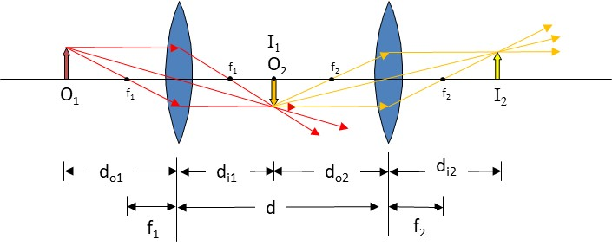
Question
In a two lens system, what is the object for the second lens?
The object
The image formed by the first lens
The image formed by the second lens
The first lens

Slide 5
Question
In a two lens system, is the image formed by the first lens inverted?
Yes
No
Sometimes
Never

Slide 6
Question
In a two lens system, is the image formed by the second lens inverted?
Yes
No
Sometimes
Never

Slide 7
I₁
O₂
f₁
f₂
O₁
f₁
f₂
I₂
d_{o1}
d_{i1}
d_{o2}
d_{i2}
s₁
s’₁
s₂
s’₂
d
f₁
f₂

Slide 8
Combination of Lenses
I₂
f₁
f₂
I₁ O₂
O₁
f₁
f₂
s₁
s’₁
s₂
d_{o1}
d_{i1}
d_{o2}
d
f₁
f₂
s’₂
d_{i2}

Slide 9
The Compound Microscope

Slide 10
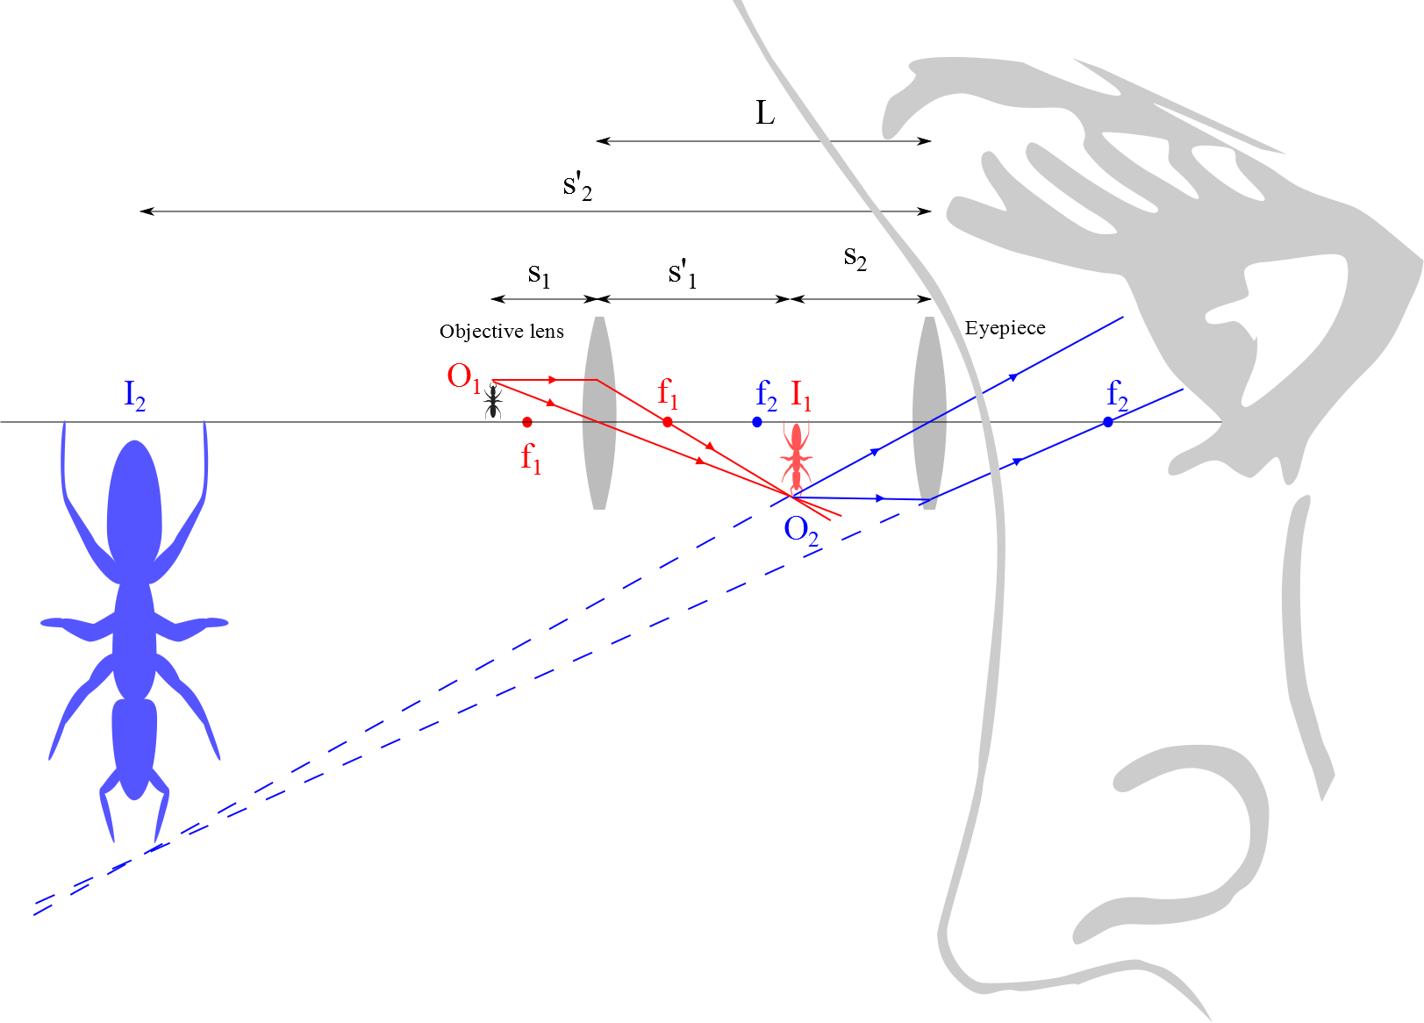
Compound Microscope
d_{ie}
d_{oo}
d_{io}
d_{oe}
I_{e}
O_{o}
f_{o}
f_{e}
I_{o}
f_{e}
f_{o}
O_{i}

Slide 11
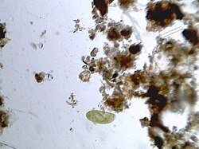
Question
In a microscope the objective lens makes an image of an object like a single celled organism like a paramecium (right). But the eyepiece also makes an image. What is the object for the eyepiece?
The paramecium
The image of the paramecium formed by the objective
The image formed by the eyepiece
The objective lens
Paramecium

Slide 12
Compound Microscope
d_{ie}
d_{oo}
d_{io}
d_{oe}
I_{e}
O_{o}
f_{o}
f_{e}
I_{o}
f_{e}
f_{o}
O_{i}

Slide 13
The telescope

Slide 14
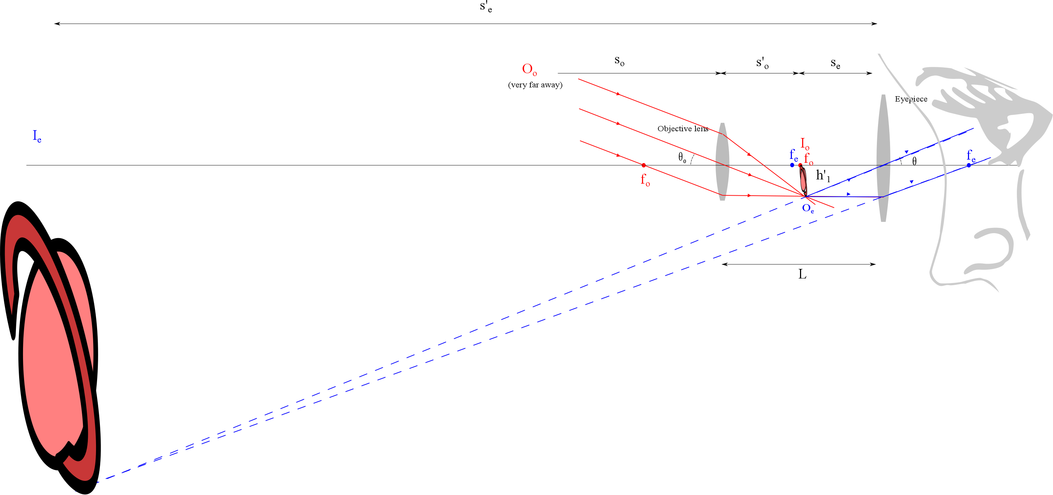
d_{ie}
d_{oo}
d_{io}
d_{oe}
h_{io}
i

Slide 15
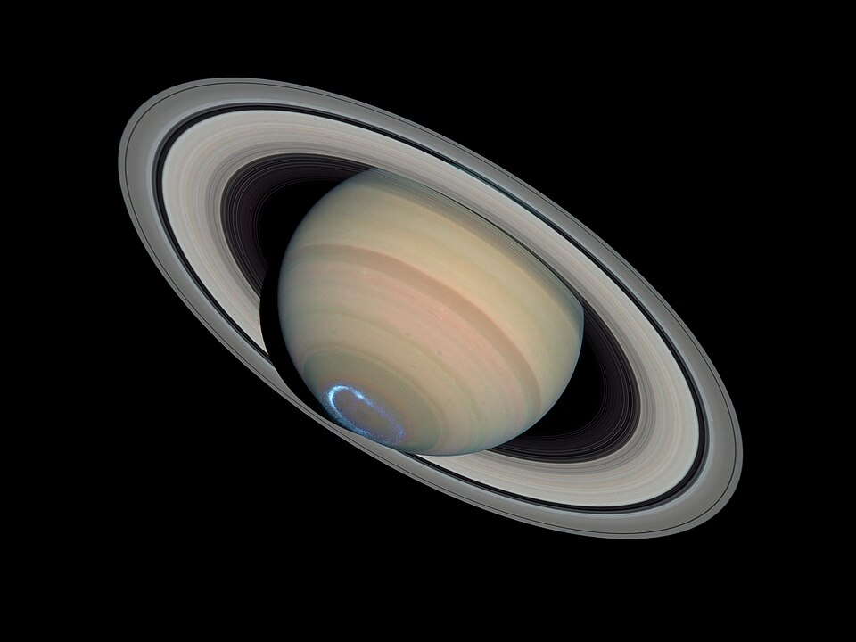
Question
In a telescope the objective lens makes an image of an object like The planet Saturn (right). But the eyepiece also makes an image. What is the object for the eyepiece?
Saturn
The image of Saturn formed by the objective
The image formed by the eyepiece
The objective lens
Saturn

Slide 16
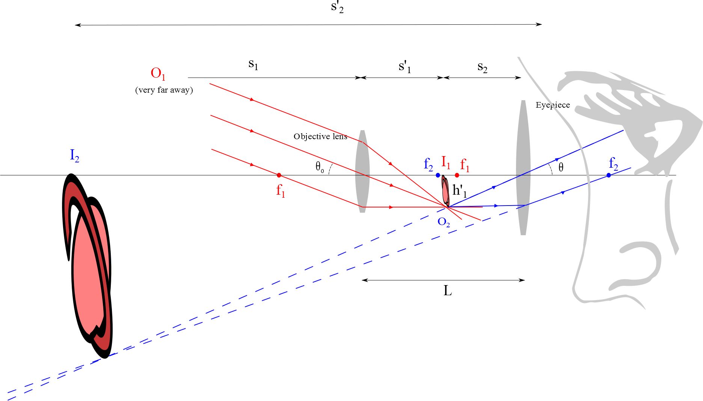
Refracting Telescope
d_{ie}
O_{o}
d_{oo}
d_{io}
d_{oe}
I_{e}
f_{e}
I_{o}
f_{o}
f_{e}
i
f_{o}
h_{io}
O_{e}

Slide 17
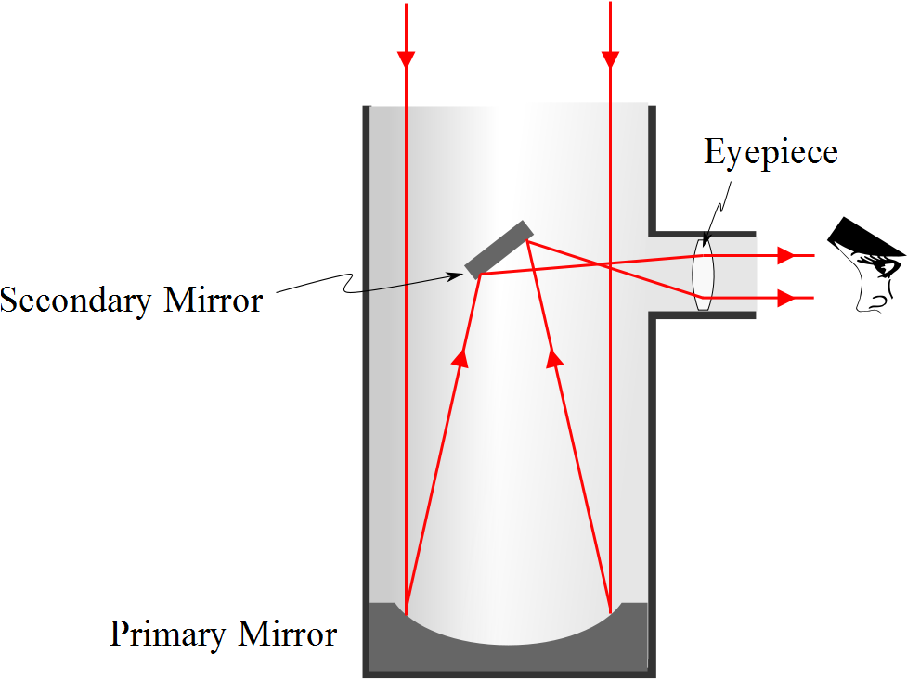
Reflecting Telescope: Newtonian

Slide 18
Examples of Telescopes
Reflecting Telescopes
Largest in the world are the 10-m diameter Keck telescopes on Mauna Kea in Hawaii
Each contains 36 hexagonally shaped, computer-controlled mirrors that work together to form a large reflecting surface
Refracting Telescopes
Largest in the world is Yerkes Observatory in Williams Bay, Wisconsin
Has a diameter of 1 m

Slide 19
Question 223.10.5
If you see a bright fringe in a “Young’s Experiment,” it must be due to
Constructive interference
Destructive interference
Beating due to different frequencies
Alians

Slide 20
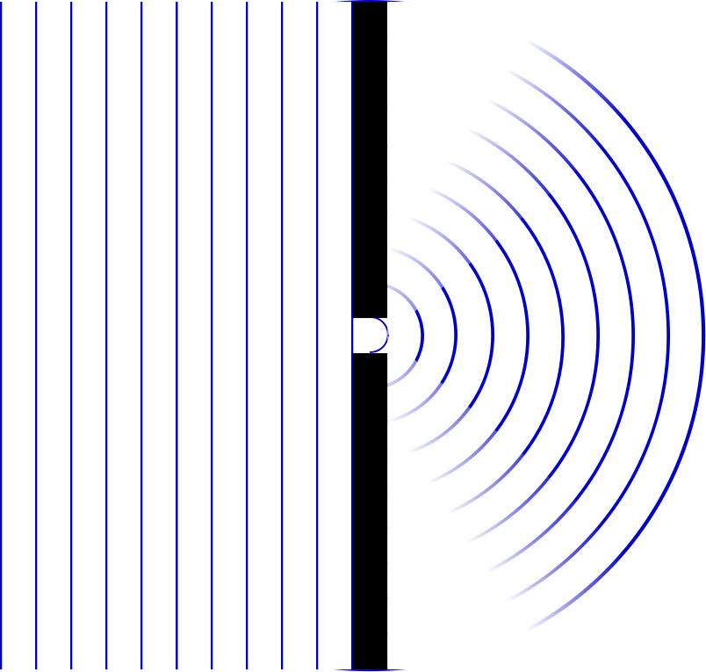

Slide 21
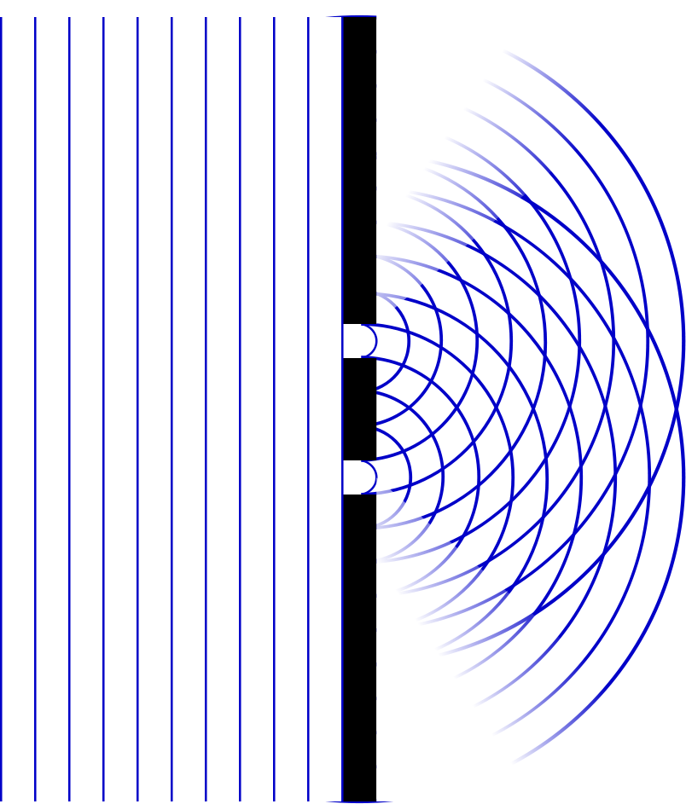

Slide 22
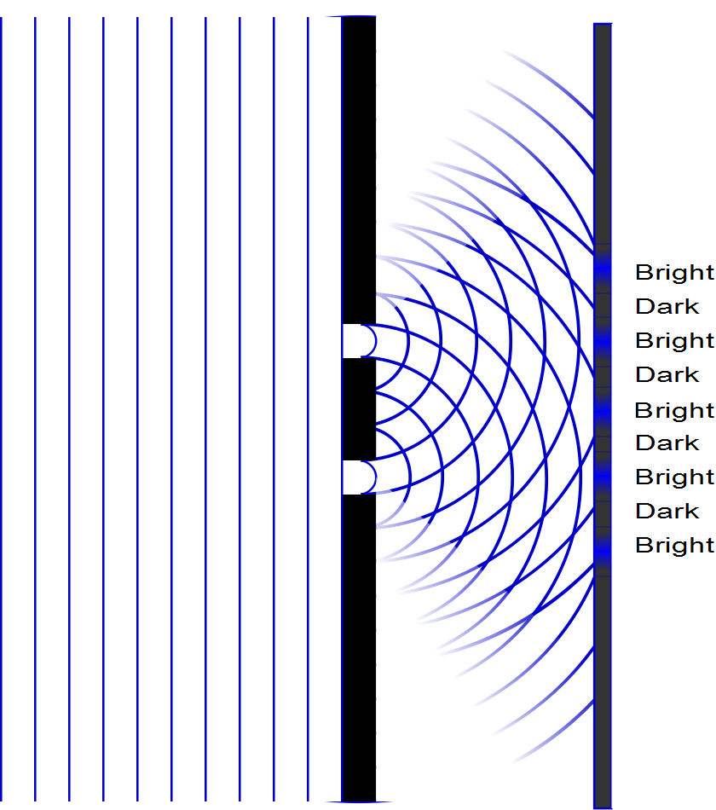

Slide 23
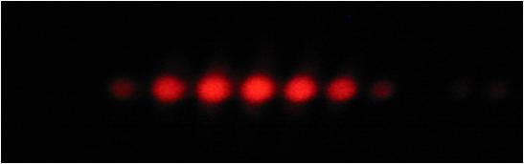

Slide 24
End

Slide 27
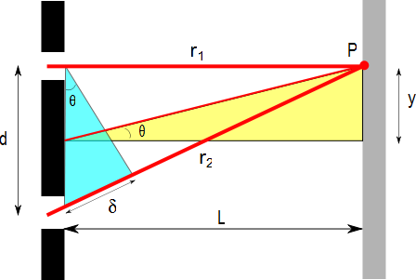
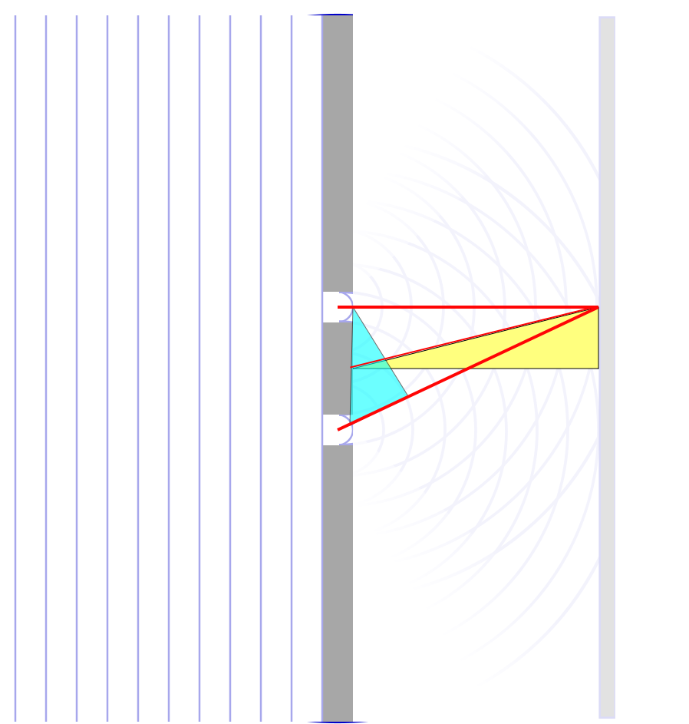

Slide 28
Question 223.10.5
If you see a bright fringe in a “Young’s Experiment,” the path difference from the fringe to the slits must be equal to
And integer number of wavelengths
And integer number of half wavelengths
π
Arctan(θ)

Slide 29
Question 223.10.6
When considering order numbers, m, the possible orders are
1, 2, 3, . . .
0, 1, 2, 3, . . .
0, ±1, ± 2, ± 3, . . .
±1, ± 2, ± 3, . . .

Slide 30
ConcepTest 24.3a Double Slits I
In a double-slit experiment, when the wavelength of the light is increased, the interference pattern
spreads out
stays the same
shrinks together
disappears

Slide 31
ConcepTest 24.3a Double Slits I
In a double-slit experiment, when the wavelength of the light is increased, the interference pattern
spreads out
stays the same
shrinks together
disappears
d sin θ = m λ
If λ is increased and d does not change, then θ must increase, so the pattern spreads out.

Slide 32
ConcepTest 24.3b Double Slits II
If instead the slits are moved farther apart (without changing the wavelength) the interference pattern
spreads out
stays the same
shrinks together
disappears

Slide 33
ConcepTest 24.3b Double Slits II
If instead the slits are moved farther apart (without changing the wavelength) the interference pattern
spreads out
stays the same
shrinks together
disappears
d sin θ = m λ
If instead d is increased and λ does not change, then θ must decrease, so the pattern shrinks together
Follow-up: When would the interference pattern disappear?

Slide 34
ConcepTest 24.4 Path Difference
In a double-slit experiment, what path difference have the waves from each slit traveled to give a minimum at the indicated position?
there is no difference
half a wavelength
one wavelength
three wavelengths
more than three wavelengths
Intensity

Slide 35
ConcepTest 24.4 Path Difference
In a double-slit experiment, what path difference have the waves from each slit traveled to give a minimum at the indicated position?
there is no difference
half a wavelength
one wavelength
three wavelengths
more than three wavelengths
λ
For Destructive Interference
δ = 1/2 λ, 3/2 λ, 5/2 λ, 7/2 λ, …
= (m + 1/2) λ
2λ
3λ
Intensity
λ/2
3λ/2
5λ/2
7λ/2

Slide 36
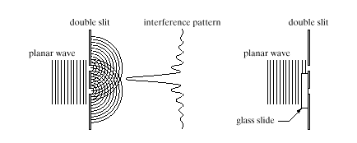
ConcepTest 24.5 Interference Pattern
pattern vanishes
pattern expands
bright and dark spots are interchanged
pattern shrinks
no change at all
An interference pattern is seen from two slits. Now cover one slit with glass, introducing a phase difference of 180° (1/2 wavelength) at the slits. How is the pattern altered?
Double slit Interference pattern
wave

Slide 37
ConcepTest 24.5 Interference Pattern
An interference pattern is seen from two slits. Now cover one slit with glass, introducing a phase difference of 180° (1/2 wavelength) at the slits. How is the pattern altered?
pattern vanishes
pattern expands
bright and dark spots are interchanged
pattern shrinks
no change at all
If the waves originating from the two slits have a phase difference of 180° when they start off, the central spot will now be dark !! To the left and the right, there will be bright spots. Thus, bright and dark spots are interchanged.
Double slit Interference pattern
wave
Follow-up: What happens when the phase difference is 90°?

Slide 40
I
Interference fringes:
due to having two slits.
φ/2
-5π
-3π
-π
π
3π
5π

Slide 41
Question 223.18.4
What is the power (in Diopters) of a lens with a focal distance of 0.5m?
5
4
3
2
1

Slide 42
Simple Magnifier
A simple magnifier consists of a single converging lens
This device is used to increase the apparent size of an object
The size of an image formed on the retina depends on the angle subtended by the eye

Slide 43
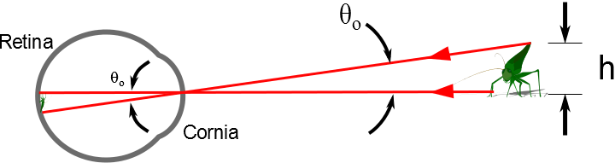

Slide 44
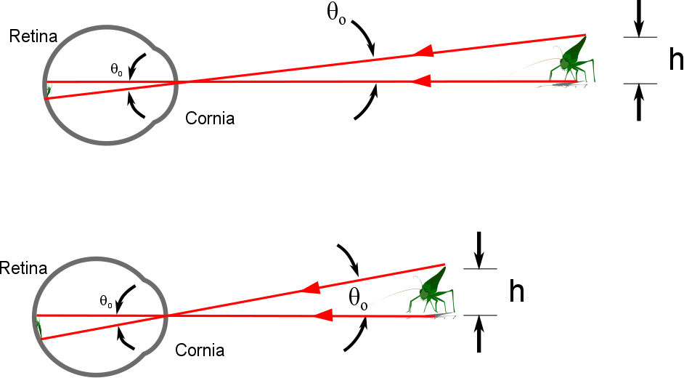

Slide 45
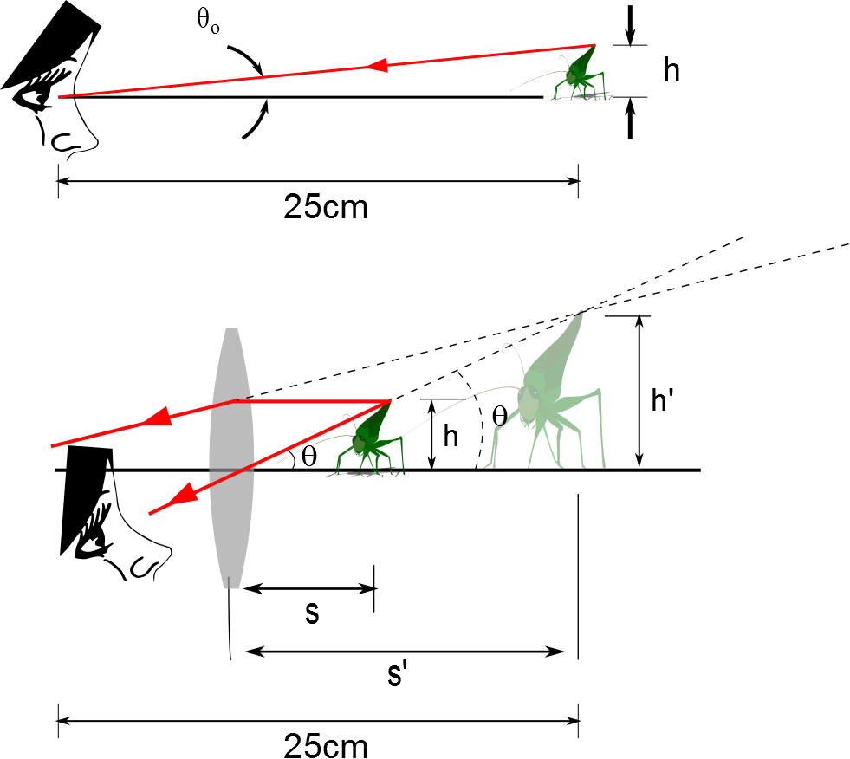
The Size of a Magnified Image
When an object is placed at the near point, the angle subtended is a maximum
The near point is about 25 cm
When the object is placed near the focal point of a converging lens, the lens forms a virtual, upright, and enlarged image

Slide 46
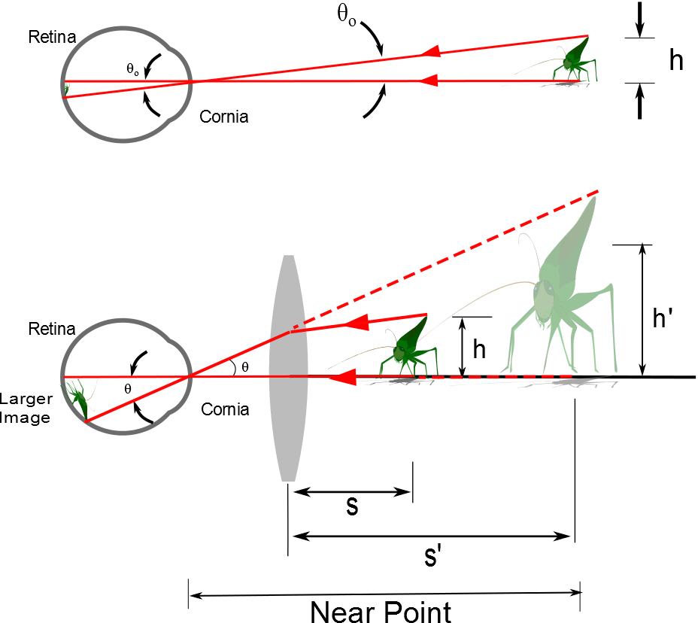
d

Slide 47
Angular Magnification
Angular magnification is defined as
The angular magnification is at a maximum when the image formed by the lens is at the near point of the eye
s’ = - 25 cm
Calculated by

Slide 48
Angular Magnification, cont.
The eye is most relaxed when the image is at infinity
Although the eye can focus on an object anywhere between the near point and infinity
For the image formed by a magnifying glass to appear at infinity, the object has to be at the focal point of the lens
The angular magnification is

Slide 49
Magnification by a Lens
With a single lens, it is possible to achieve angular magnification up to about 4 without serious aberrations
With multiple lenses, magnifications of up to about 20 can be achieved
The multiple lenses can correct for aberrations

Slide 50
The Compound Microscope

Slide 51
Compound Microscope

Slide 52
The telescope

Slide 54
Refracting Telescope

Slide 55
Reflecting Telescope: Newtonian

Slide 56
Examples of Telescopes
Reflecting Telescopes
Largest in the world are the 10-m diameter Keck telescopes on Mauna Kea in Hawaii
Each contains 36 hexagonally shaped, computer-controlled mirrors that work together to form a large reflecting surface
Refracting Telescopes
Largest in the world is Yerkes Observatory in Williams Bay, Wisconsin
Has a diameter of 1 m

Slide 57
Resolution

Slide 58
Question 223.19.1
Resolution is
The ending argument in a debate
The ability to distinguish separate point sources in an optical image
The distance between bright fringes in a diffraction pattern
The distance between dark fringes in a diffraction pattern

Slide 59
Question 233.19.2
Cat’s eyes have pupils that can be modeled as vertical slits. At night, would cats be more successful in resolving
Headlights on a distant car
Vertically separated lights on the mast of a distant boat?

Slide 60
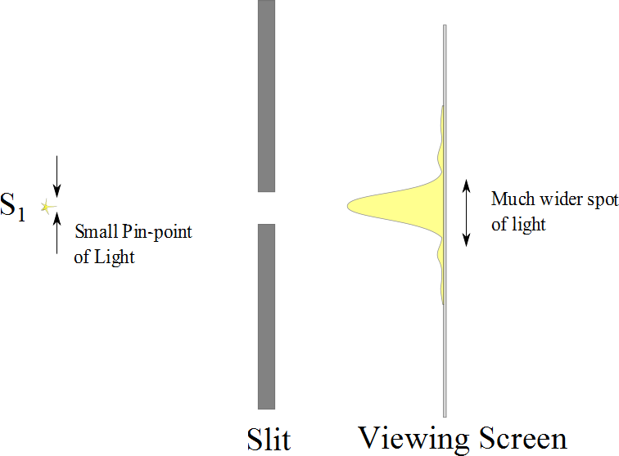

Slide 61
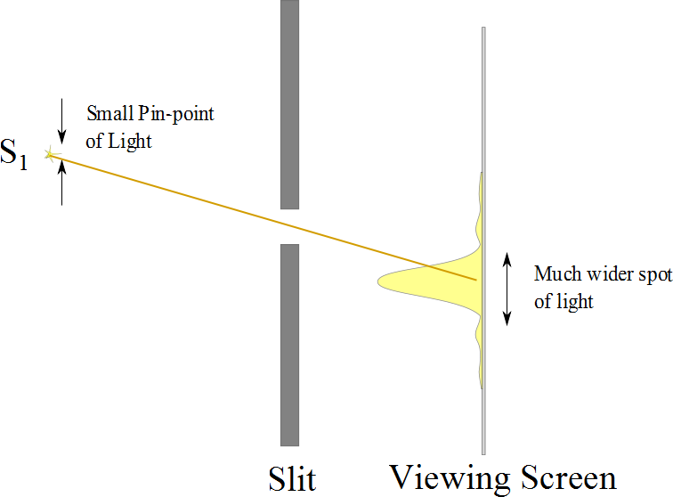

Slide 62
Resolution

Slide 63
Resolution
The ability of optical systems to distinguish between closely spaced objects is limited because of the wave nature of light
If two sources are far enough apart to keep their central maxima from overlapping, their images can be distinguished
The images are said to be resolved
If the two sources are close together, the two central maxima overlap and the images are not resolved

Slide 64


Slide 65
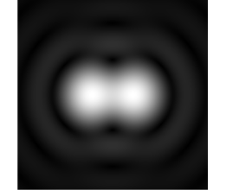

Slide 66
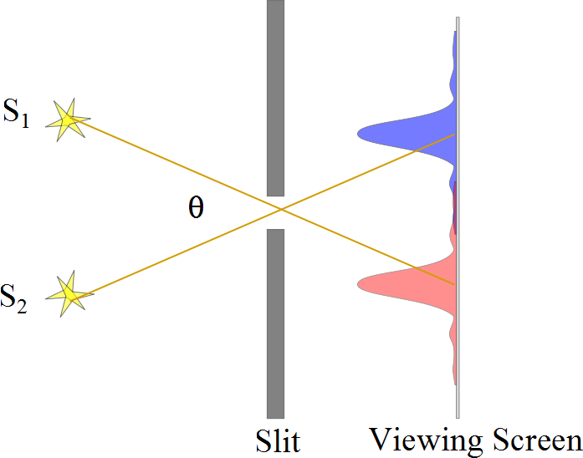
Resolved Images, Example

Slide 67
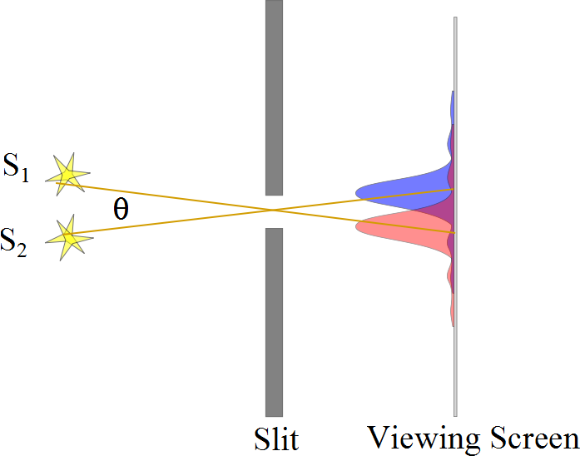
Barely Resolved, Example

Slide 68
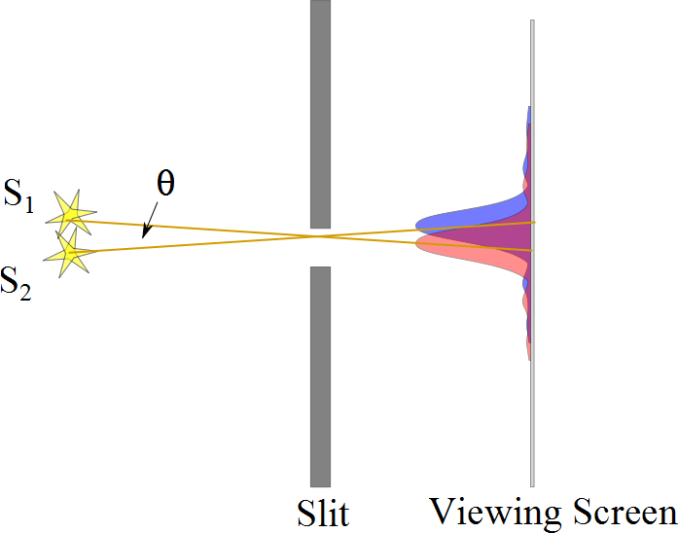
Images Not Resolved, Example

Slide 69
Resolution
The ability of optical systems to distinguish between closely spaced objects is limited because of the wave nature of light
If two sources are far enough apart to keep their central maxima from overlapping, their images can be distinguished
The images are said to be resolved
If the two sources are close together, the two central maxima overlap and the images are not resolved

Slide 71
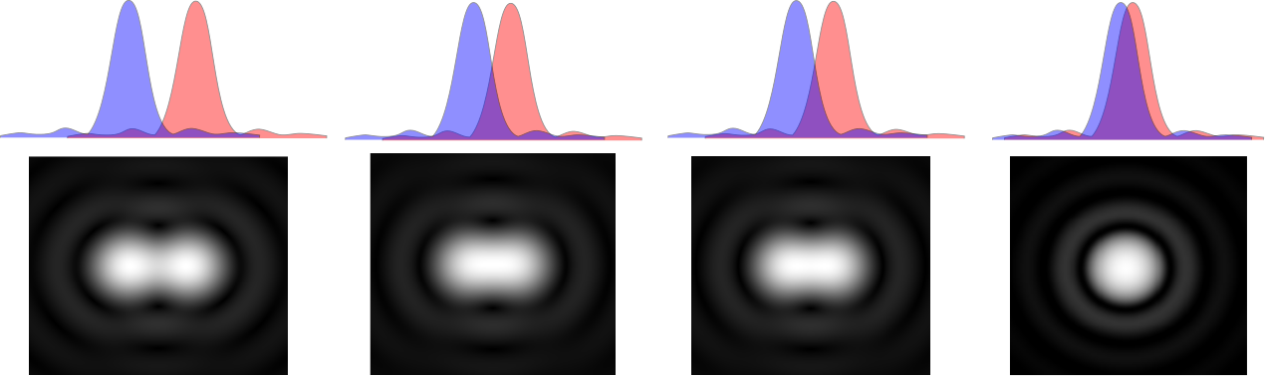

Slide 73
Resolution, Rayleigh’s Criterion
When the central maximum of one image falls on the first minimum of another image, the images are said to be just resolved
This limiting condition of resolution is called Rayleigh’s criterion

Slide 74
Resolution, Rayleigh’s Criterion, Equation
The angle of separation, θ_{min}, is the angle subtended by the sources for which the images are just resolved
Since λ << a in most situations, sin θ is very small and sin θ ≈ θ
Therefore, the limiting angle (in rad) of resolution for a slit of width a is
To be resolved, the angle subtended by the two sources must be greater than θ_{min}

Slide 75
Circular Apertures
The diffraction pattern of a circular aperture consists of a central bright disk surrounded by progressively fainter bright and dark rings
The limiting angle of resolution of the circular aperture is
D is the diameter of the aperture

Slide 76
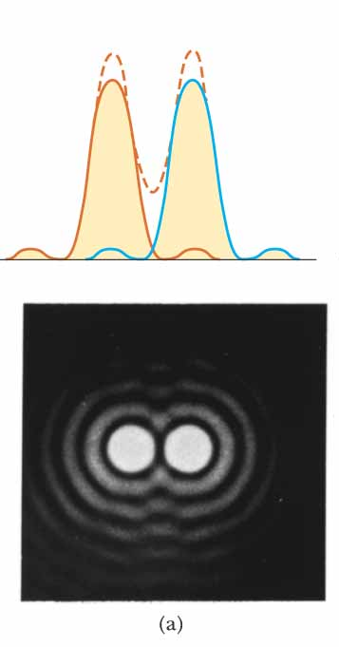
Circular Apertures, Well Resolved
The sources are far apart
The images are well resolved
The solid curves are the individual diffraction patterns
The dashed lines are the resultant pattern

Slide 77
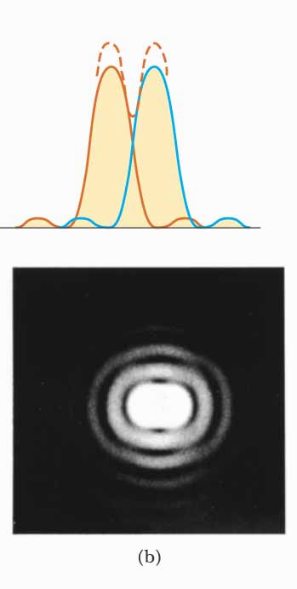
Circular Apertures, Just Resolved
The sources are separated by an angle that satisfies Rayleigh’s criterion
The images are just resolved
The solid curves are the individual diffraction patterns
The dashed lines are the resultant pattern

Slide 78
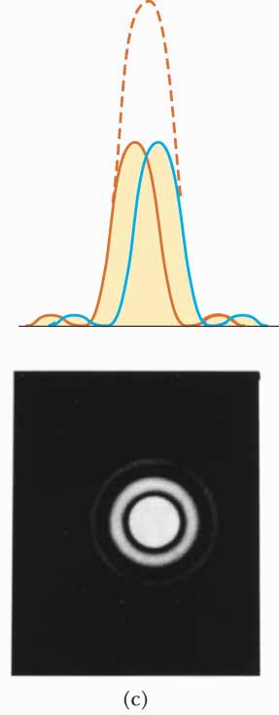
Circular Apertures, Not Resolved
The sources are close together
The images are unresolved
The solid curves are the individual diffraction patterns
The dashed lines are the resultant pattern

Slide 79
Completely Resolved
Rayleigh Criterion
Sparrow Criterion
Unresolved

Slide 80
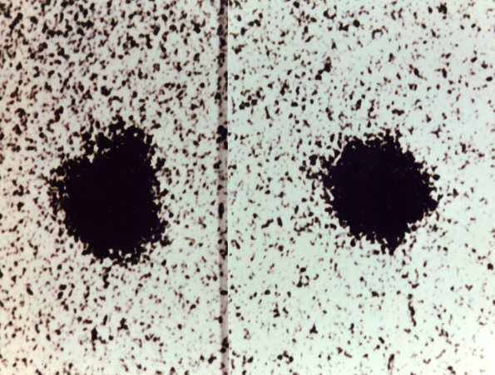
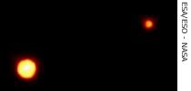
Resolution, Example
Charon
Pluto
Pluto and its moon, Charon
Left: Earth-based telescope is blurred
Right: Hubble Space Telescope clearly resolves the two objects

